Slide 1
Big Data Science Mahsa Rahimian University of Colorado Dr. Farnoush kashani Subject of Project: Mall Customers Segmentation — Using Machine Learning

Slide 2
Outline
Introduction
Problem statement
Methods
Tools
challenges
Results
Plans to mitigate challenges

Slide 3
introduction
In this Data Science R project, I will execute an interesting application of machine learning called customer segmentation. Customer Segmentation can play crucial role in commercial organization when they are looking for best customer.
Customer Segmentation is a crucial application in unsupervised learning. Cluster techniques can allow commercial companies to identify the several segments of their customers which enable the organization to target the potential user base.
The technologies that I am going to use is Python libraries to implement k-means algorithm.

Slide 4
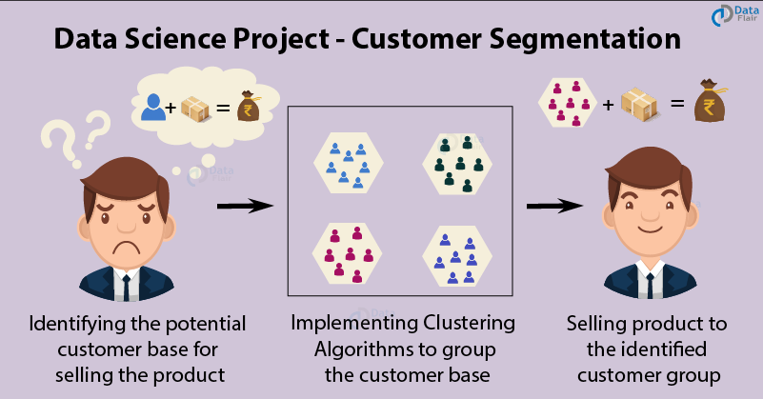
Problem statement
Customer segmentation can divide customers into several groups which share a similarity in different ways that is based on gender, interests, miscellaneous spending habits, and age. This project can help organization to solve a big problem which is target the potential customer for a particular product.

Slide 5
Problem statement
Companies that deploy customer segmentation are under the notion that every customer has different requirements and require a specific marketing effort to address them appropriately. Companies aim to gain a deeper approach of the customer they are targeting.
Thus, they should target the requirements of each and every customer. Accordingly, commercial organizations can gain deeper knowledge about customer’s preferences which will cause maximum profit to the company.

Slide 6
Methods

Slide 7
tools

Slide 8
challanges

Slide 9
results

Slide 10
Plans to mitigate challenges

